Slide 2
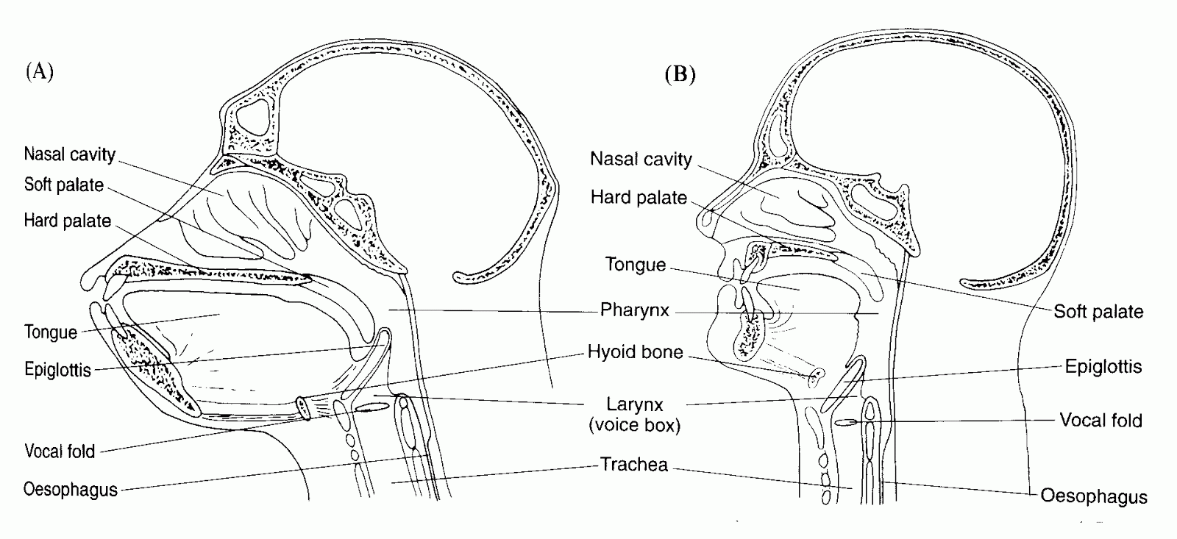
Archonta: Primates! Haplorrhini: Catarrhini
Notes:
https://www.youtube.com/watch?v=7iaQBIncj4M

Slide 3
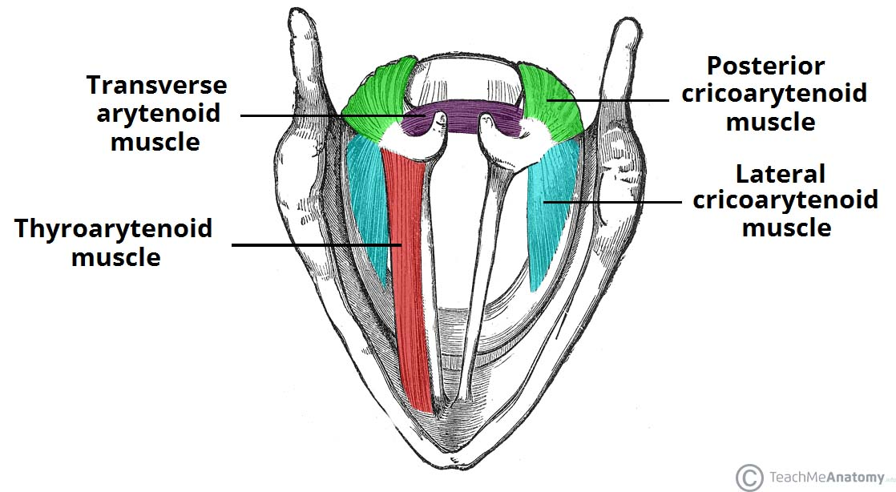
Archonta: Primates! Haplorrhini: Catarrhini
Notes:
https://www.youtube.com/watch?v=7iaQBIncj4M

Slide 4
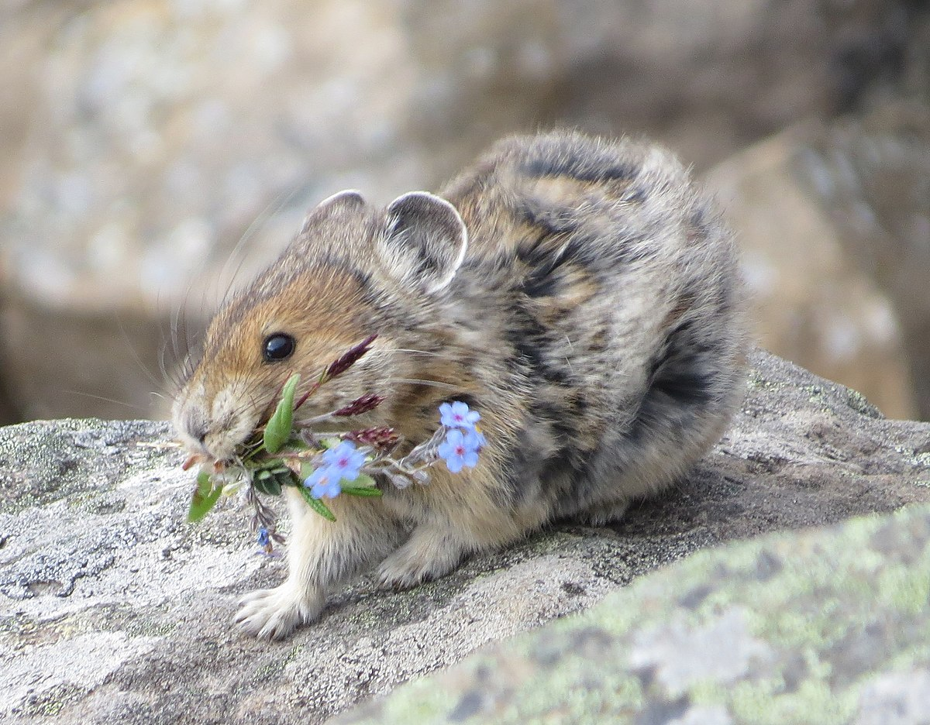
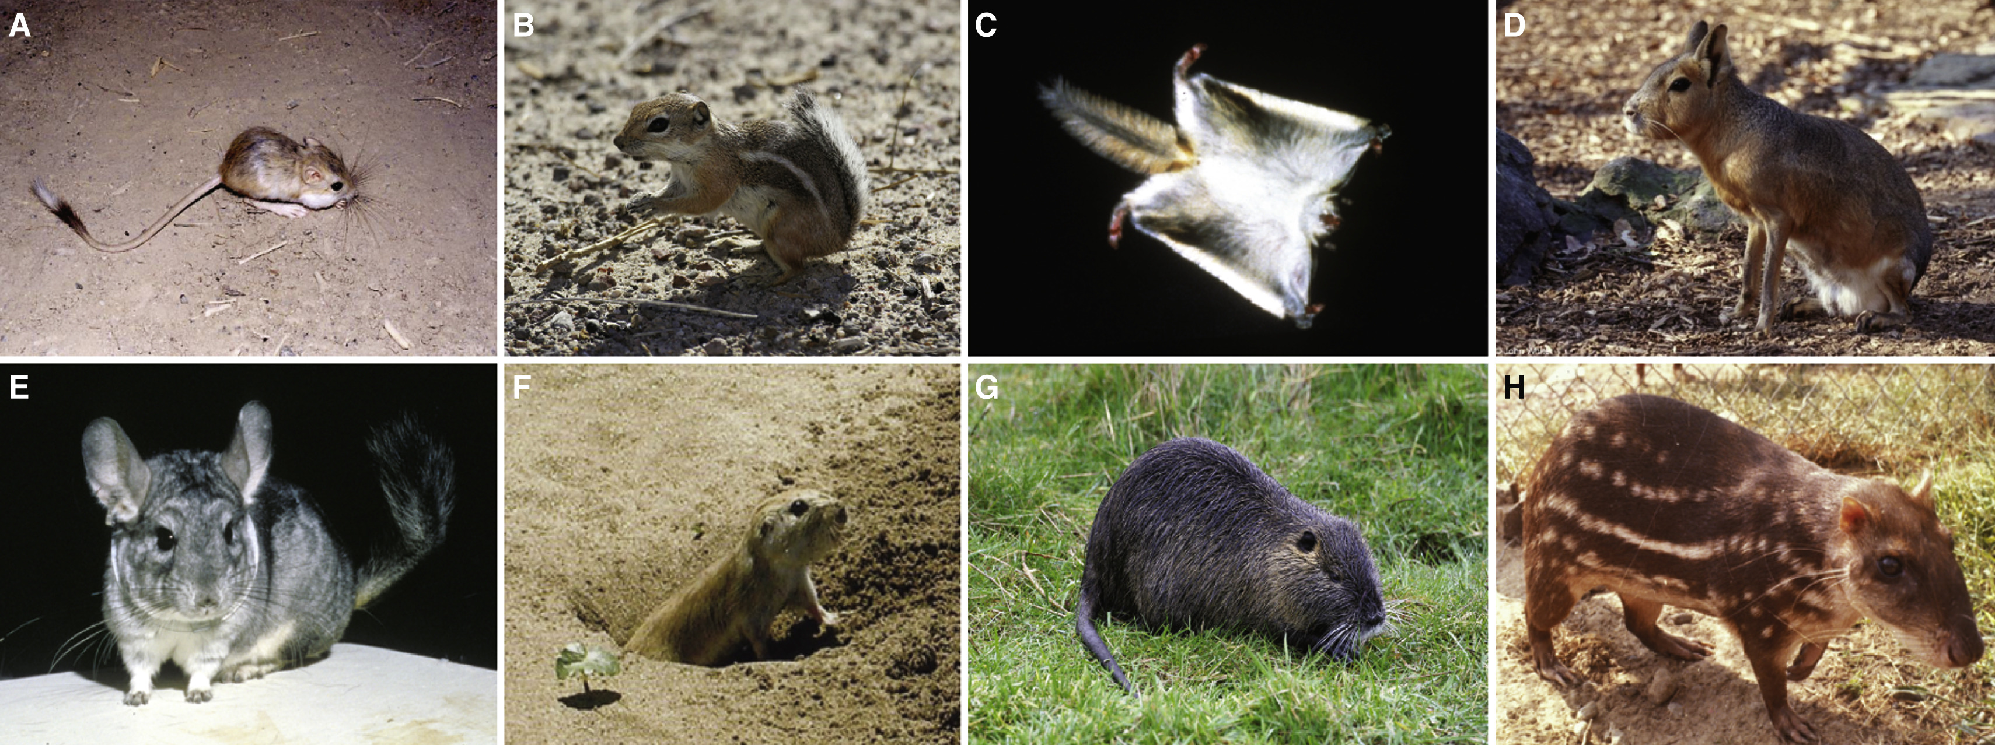
Glires – Over 40% of all mammals!

Slide 5
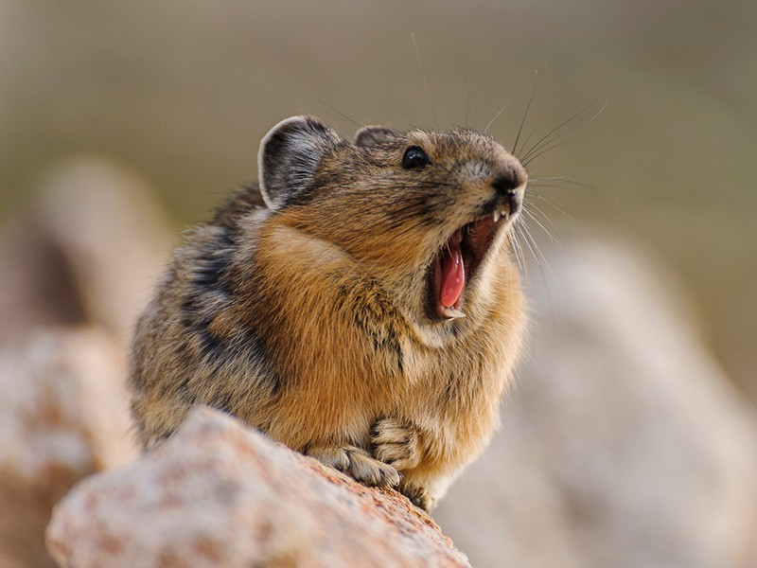
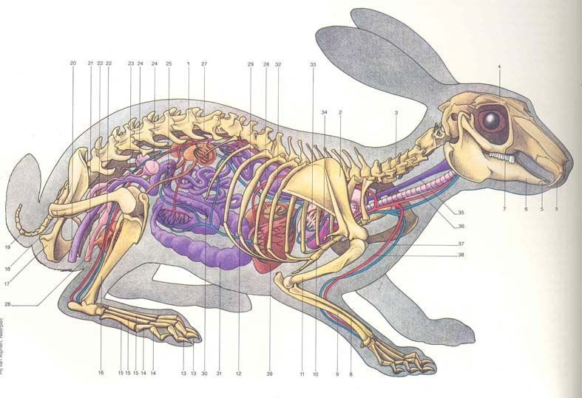
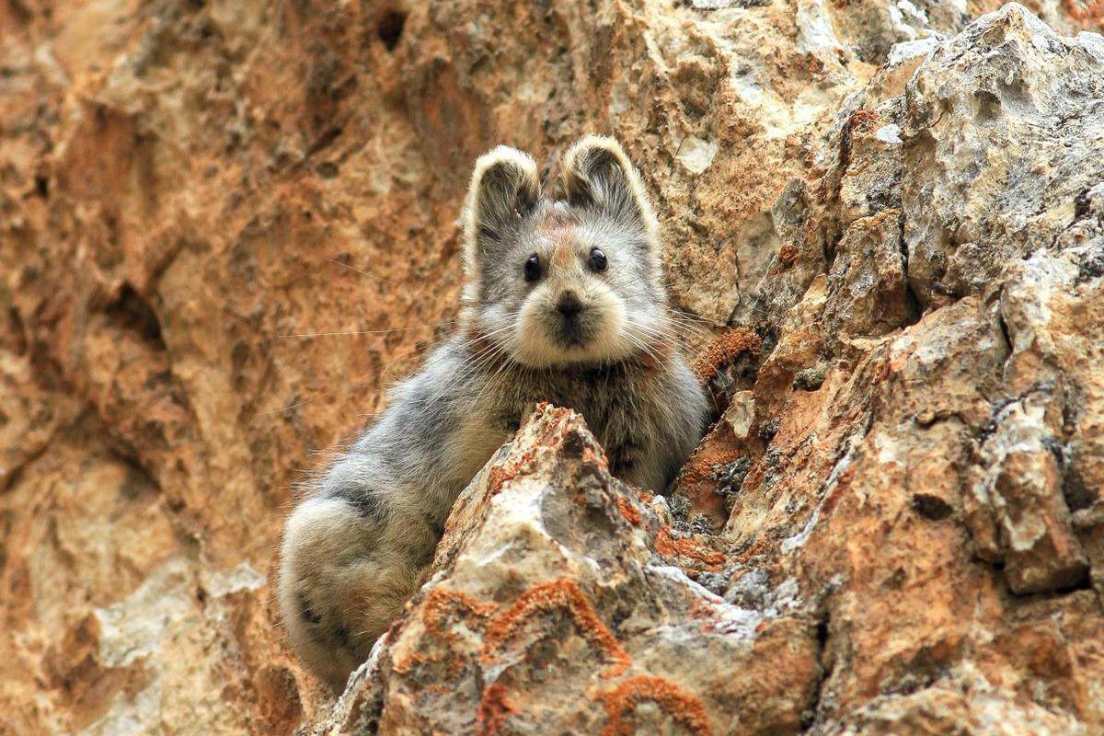
Glires: Lagomorpha (~70 species)
Rabbits & Pikas

Slide 6
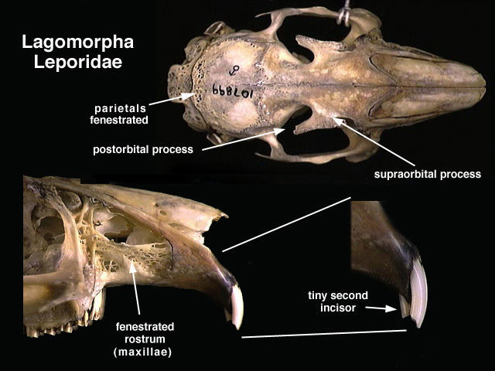
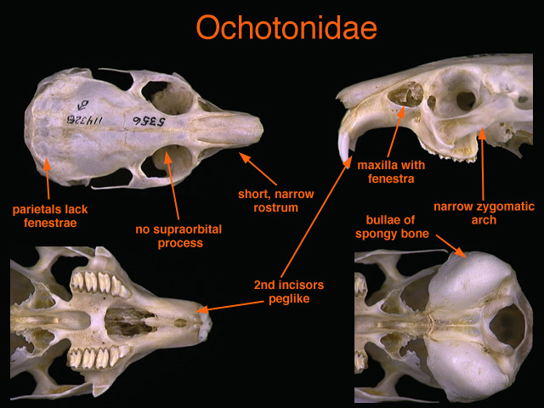
Glires: Lagomorpha (~70 species)

Slide 7
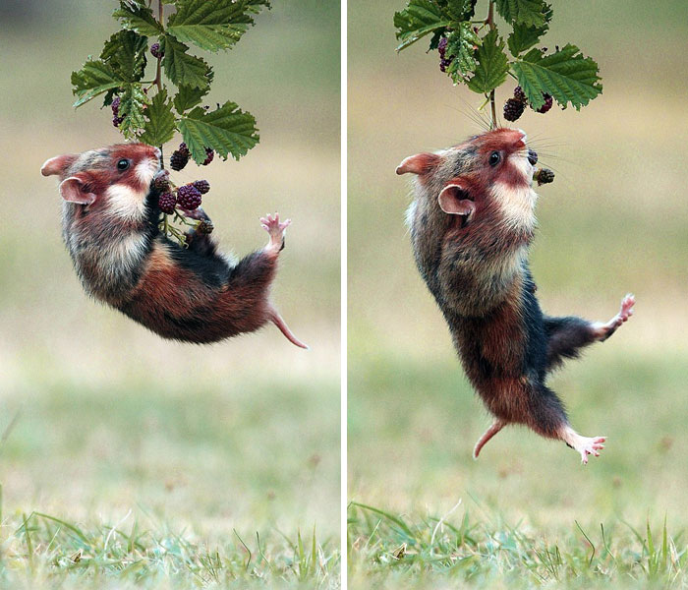
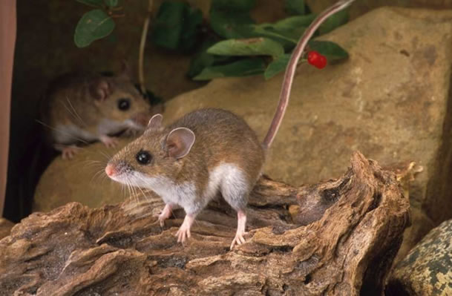
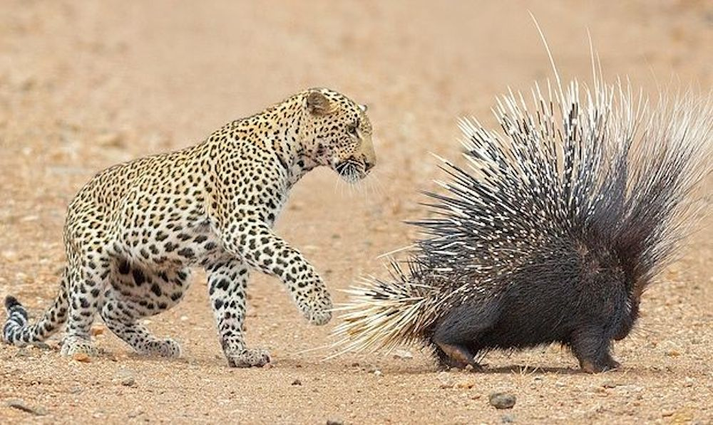
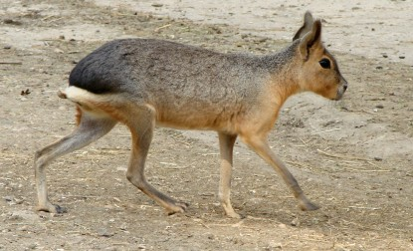
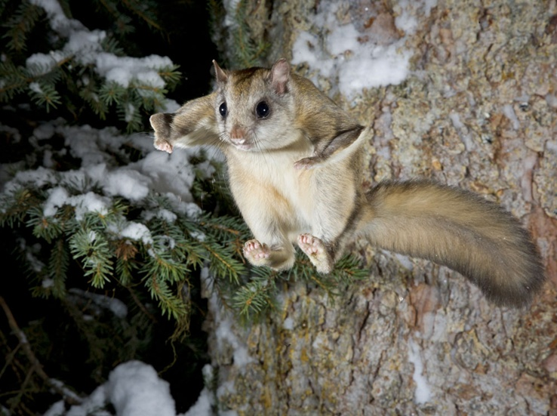
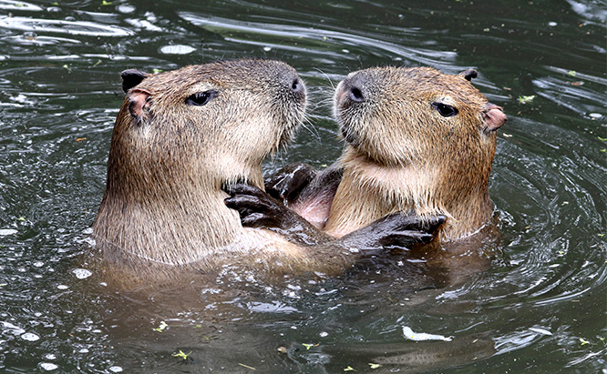
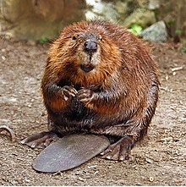
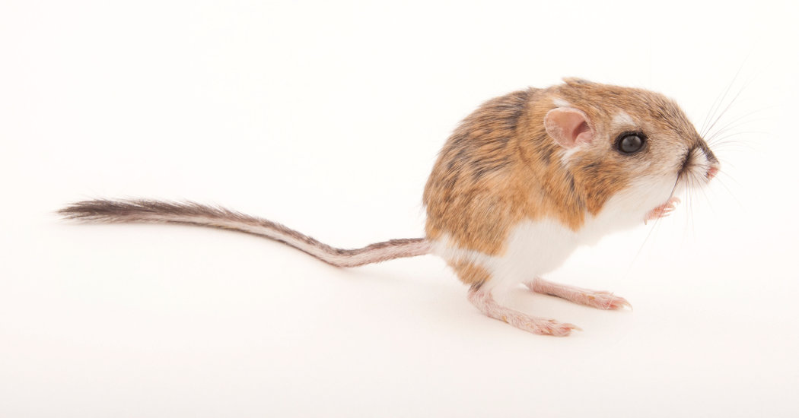
Glires: Rodentia (2,500+ sp)

Slide 8
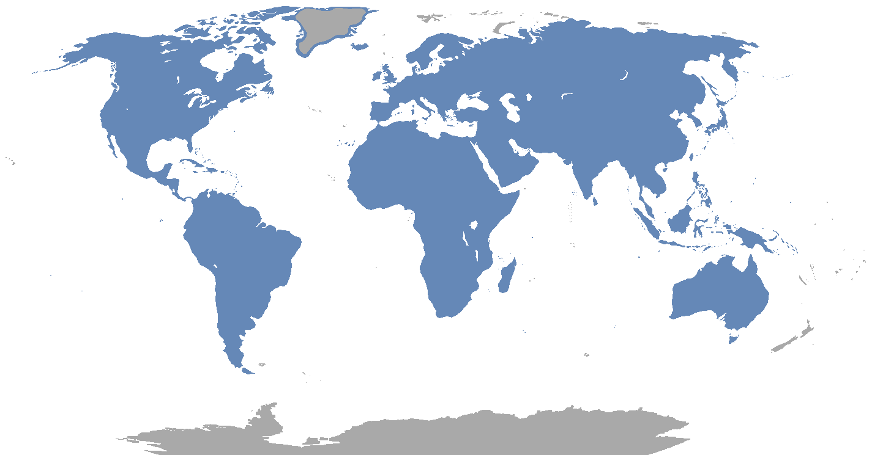
Glires: Rodentia

Slide 9
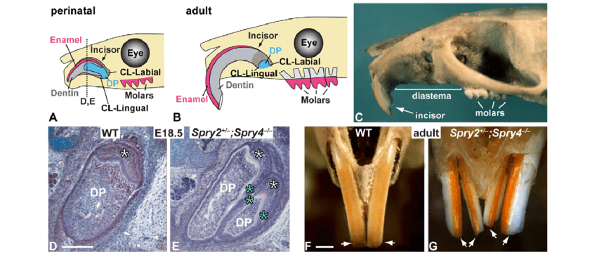
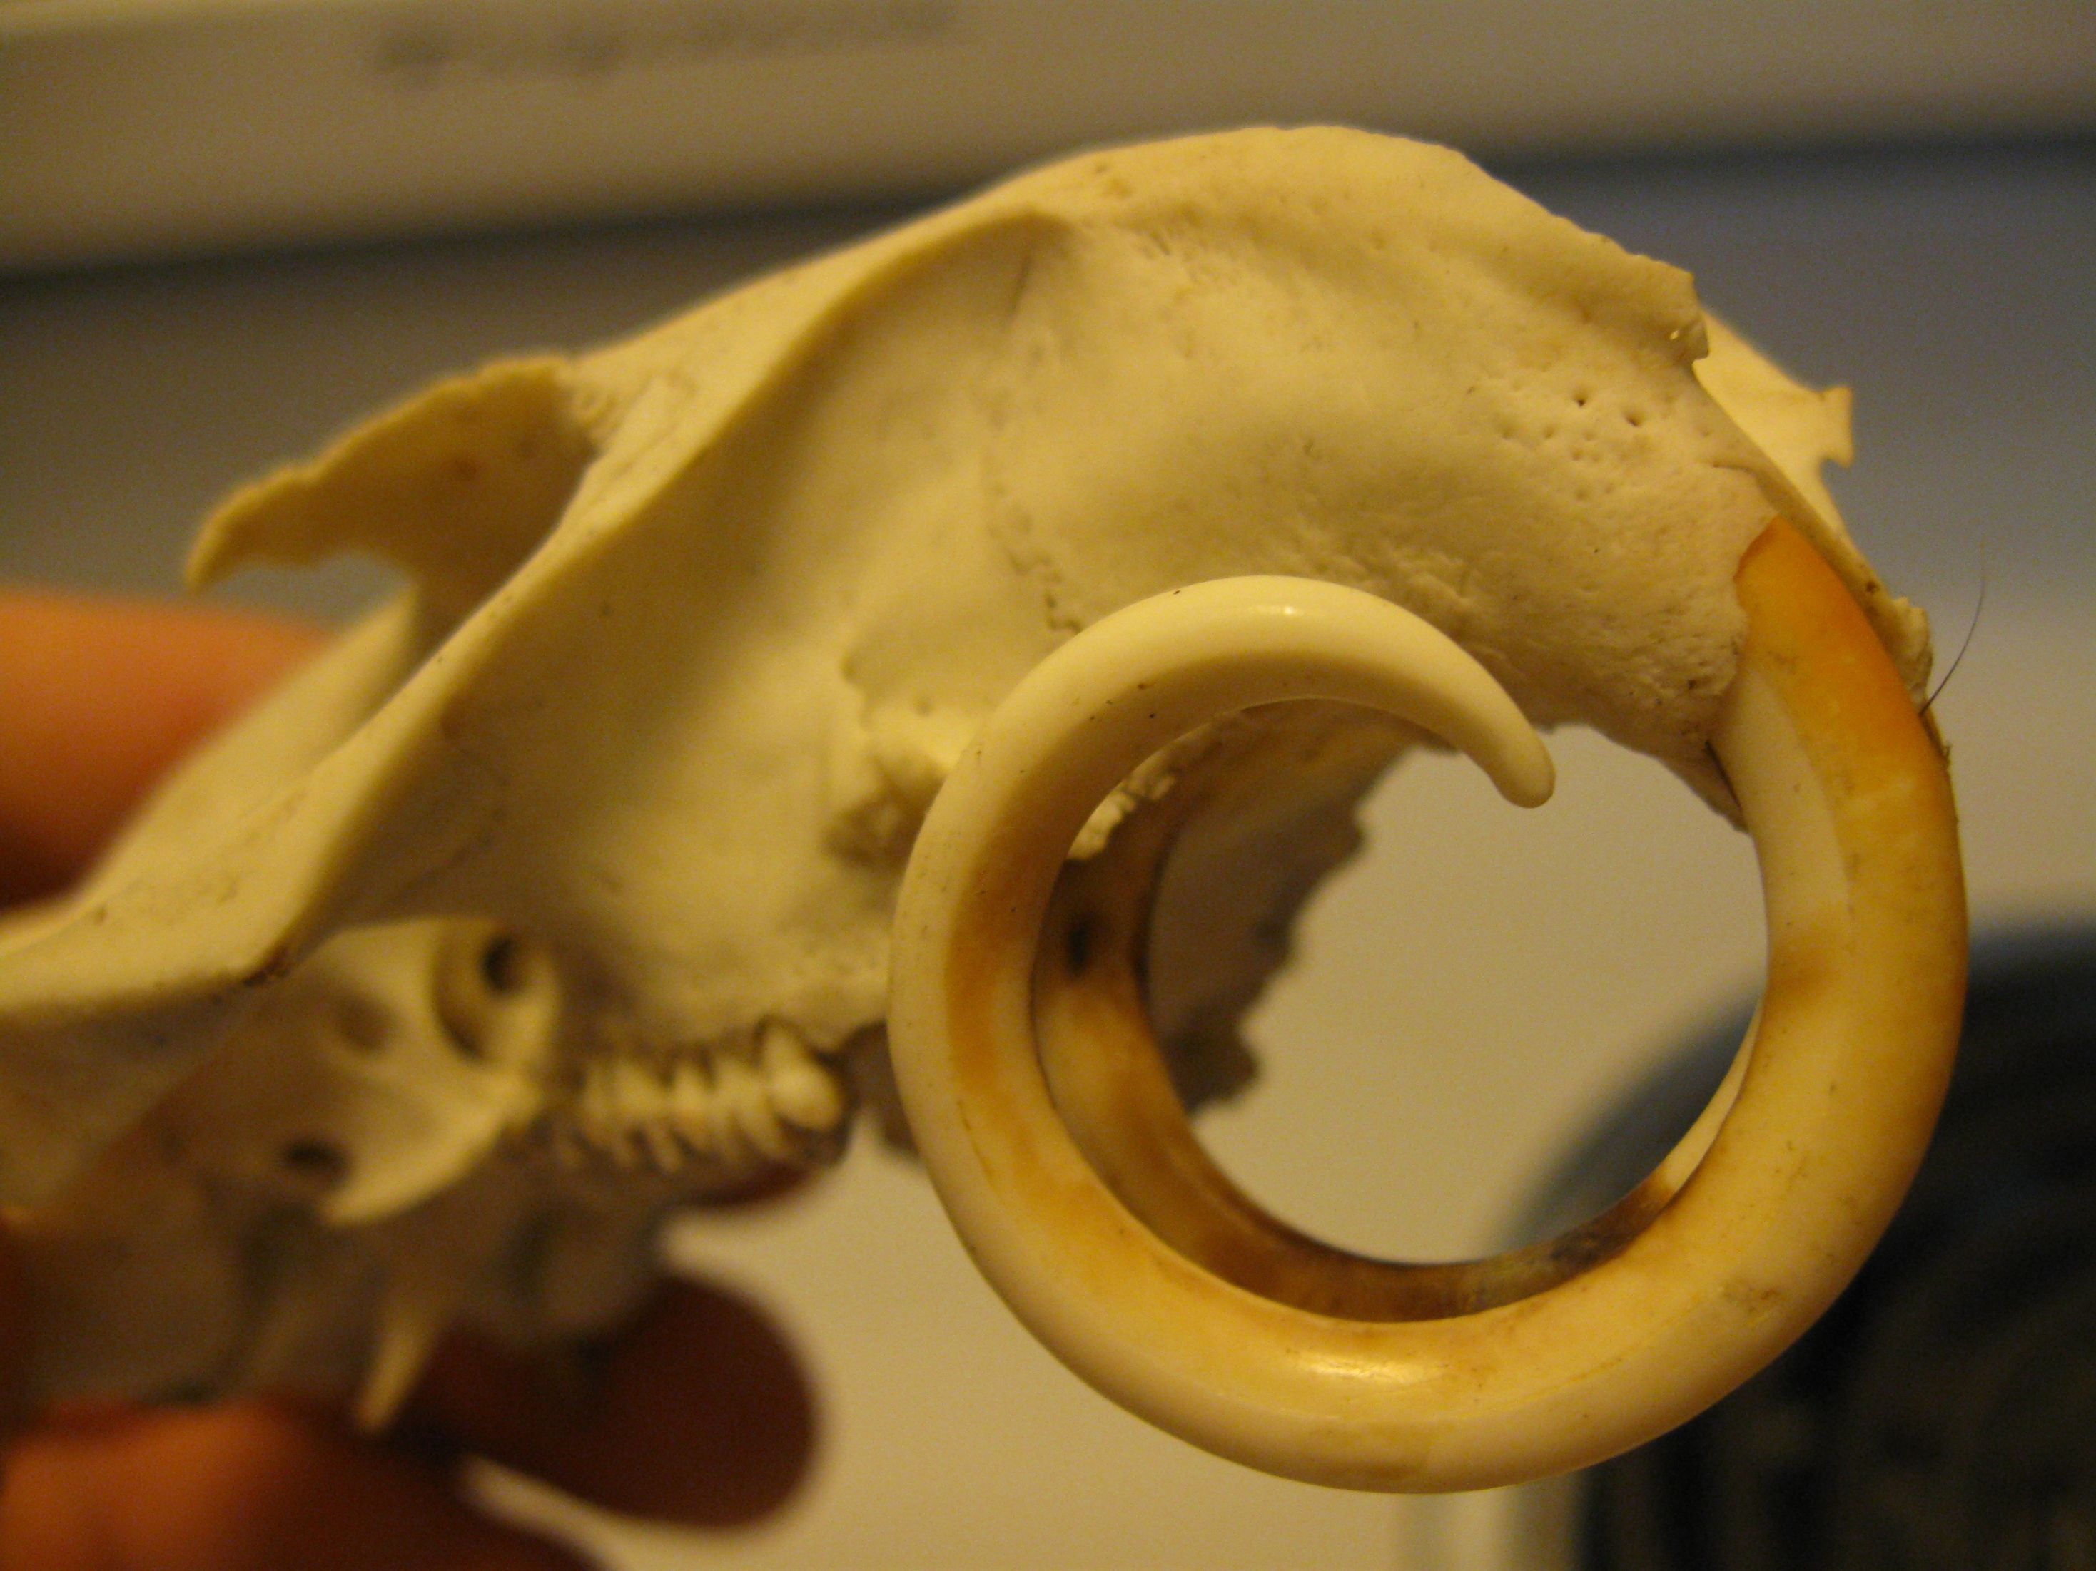
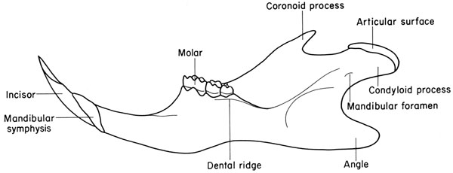
Glires: Rodentia

Slide 10
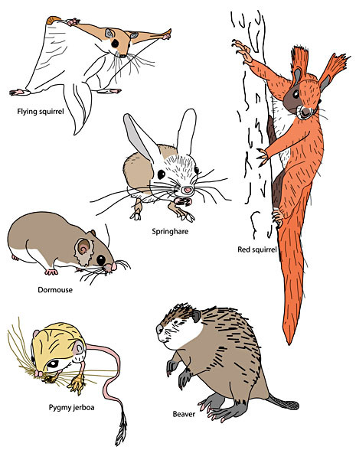
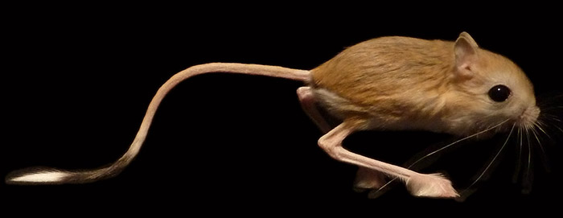
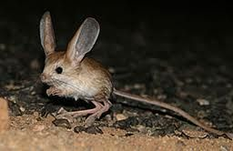
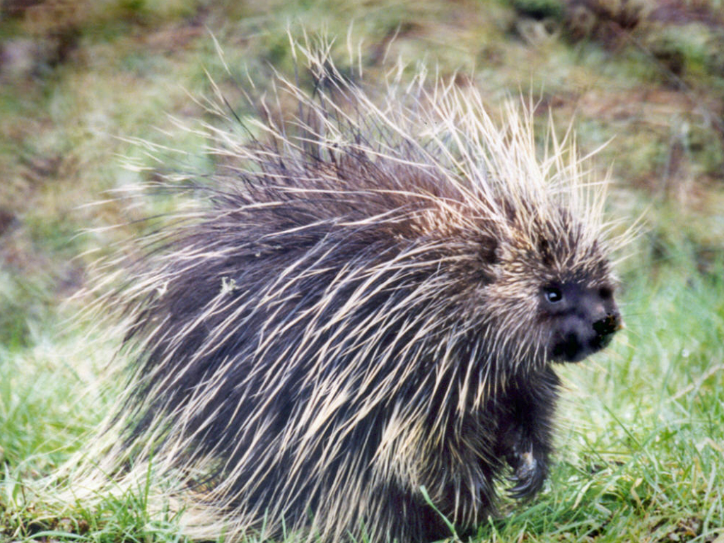
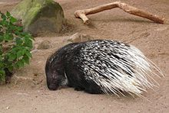
Glires: Rodentia

Slide 11
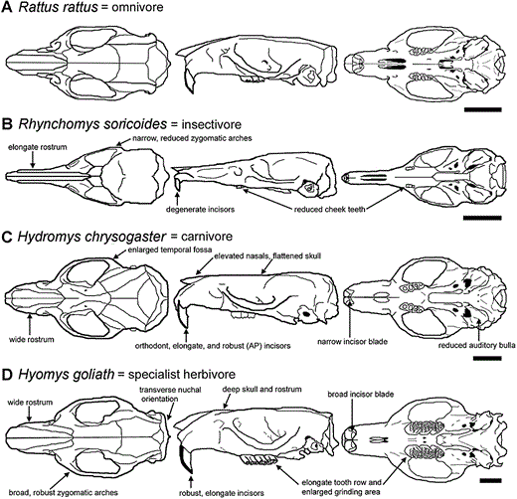
Glires: Rodentia

Slide 12
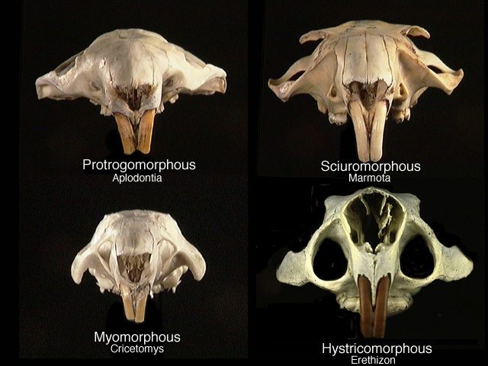
Glires: Rodentia

Slide 13
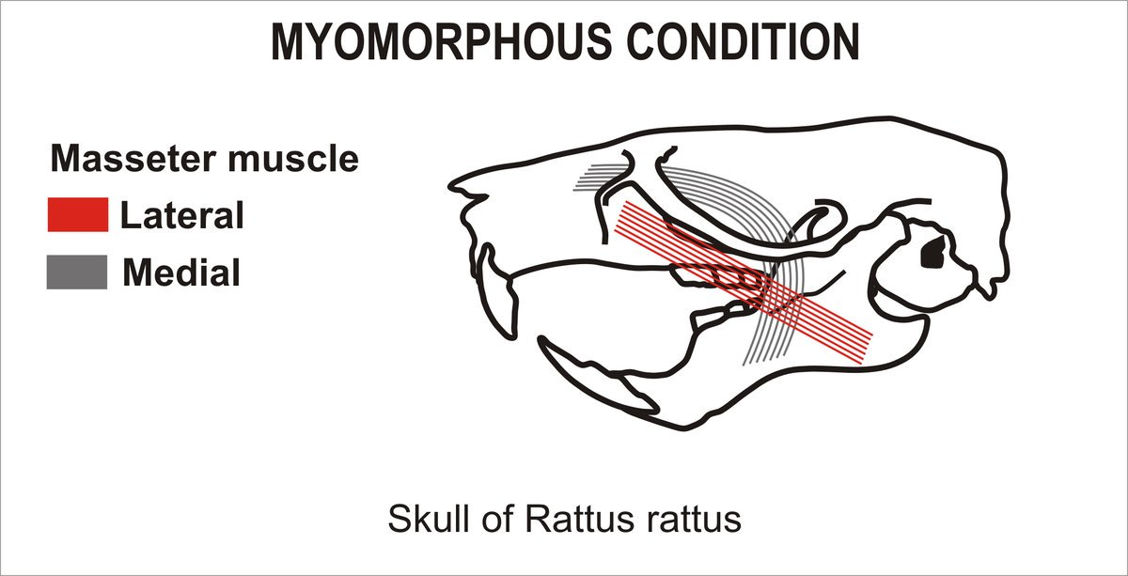
Glires: Rodentia

Slide 14
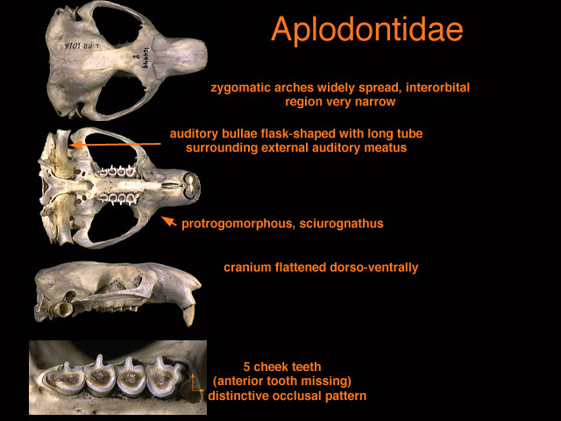
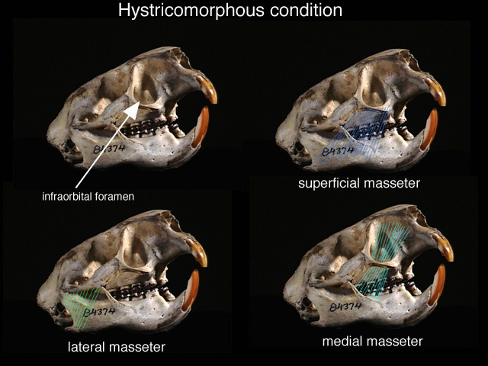
Glires: Rodentia

Slide 15
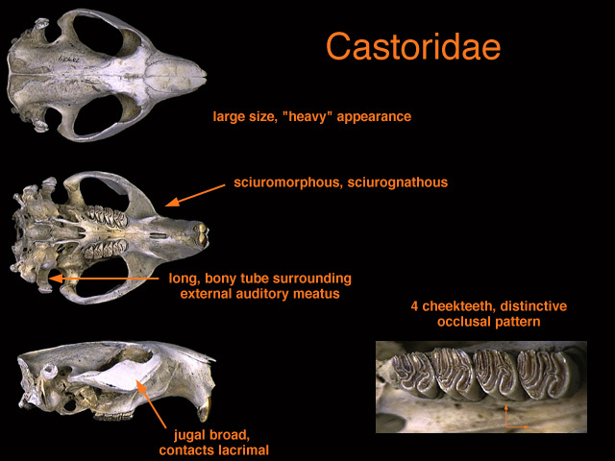
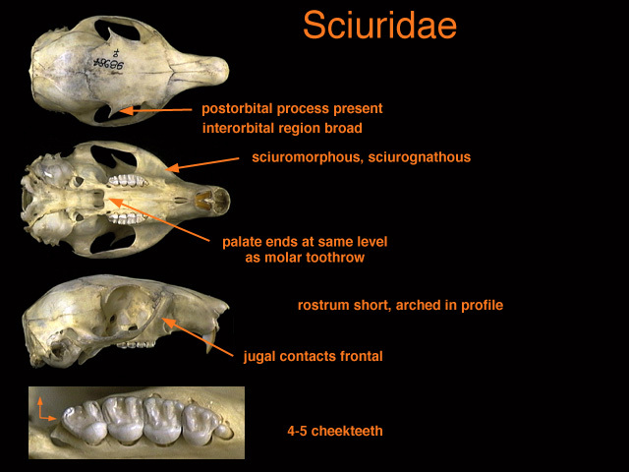
Glires: Rodentia

Slide 16
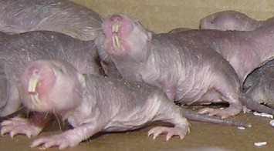
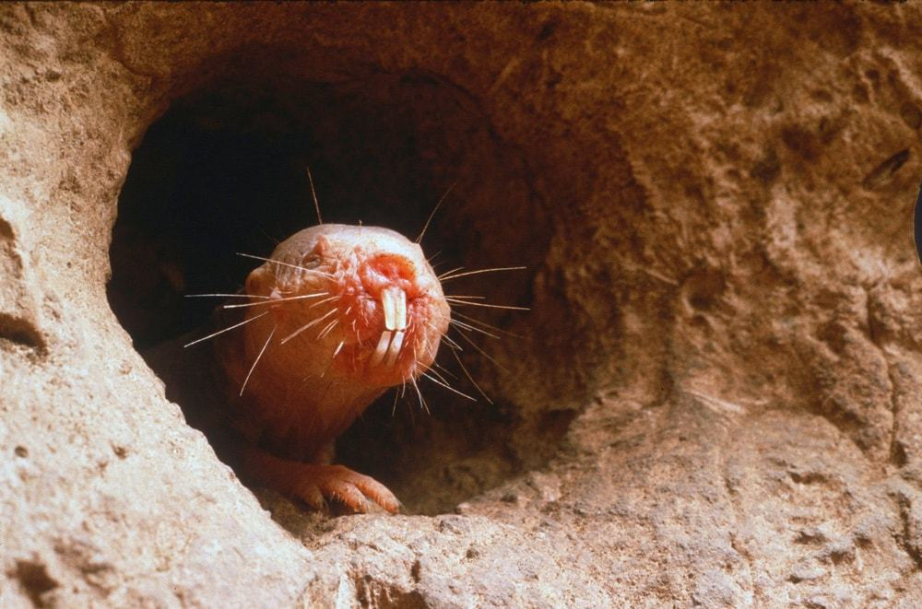
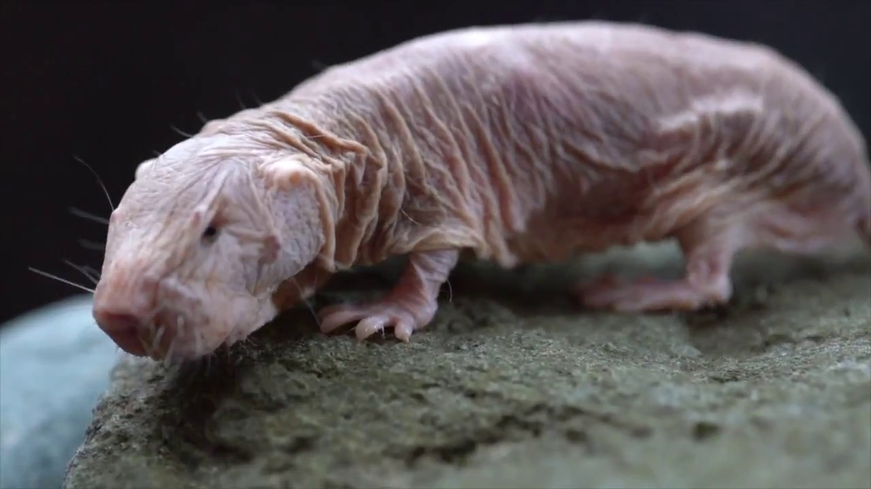
Glires: Rodentia
Notes:
Reduced pain reception
Essentially no homeothermy
No cancer
Eusociality
“In response to high temperatures and inflammation around sensory neurons, nerve growth factor (NGF) molecules bind to a receptor called TrkA. This kicks off a cascade of chemical signals that "sensitize" an ion channel -- called TRPV1 -- on the surface of the sensory neuron so that it opens. Once TRPV1 opens, it results in sensory nerve firing that tells the brain to register pain at temperatures that are not normally painful.”

Slide 17
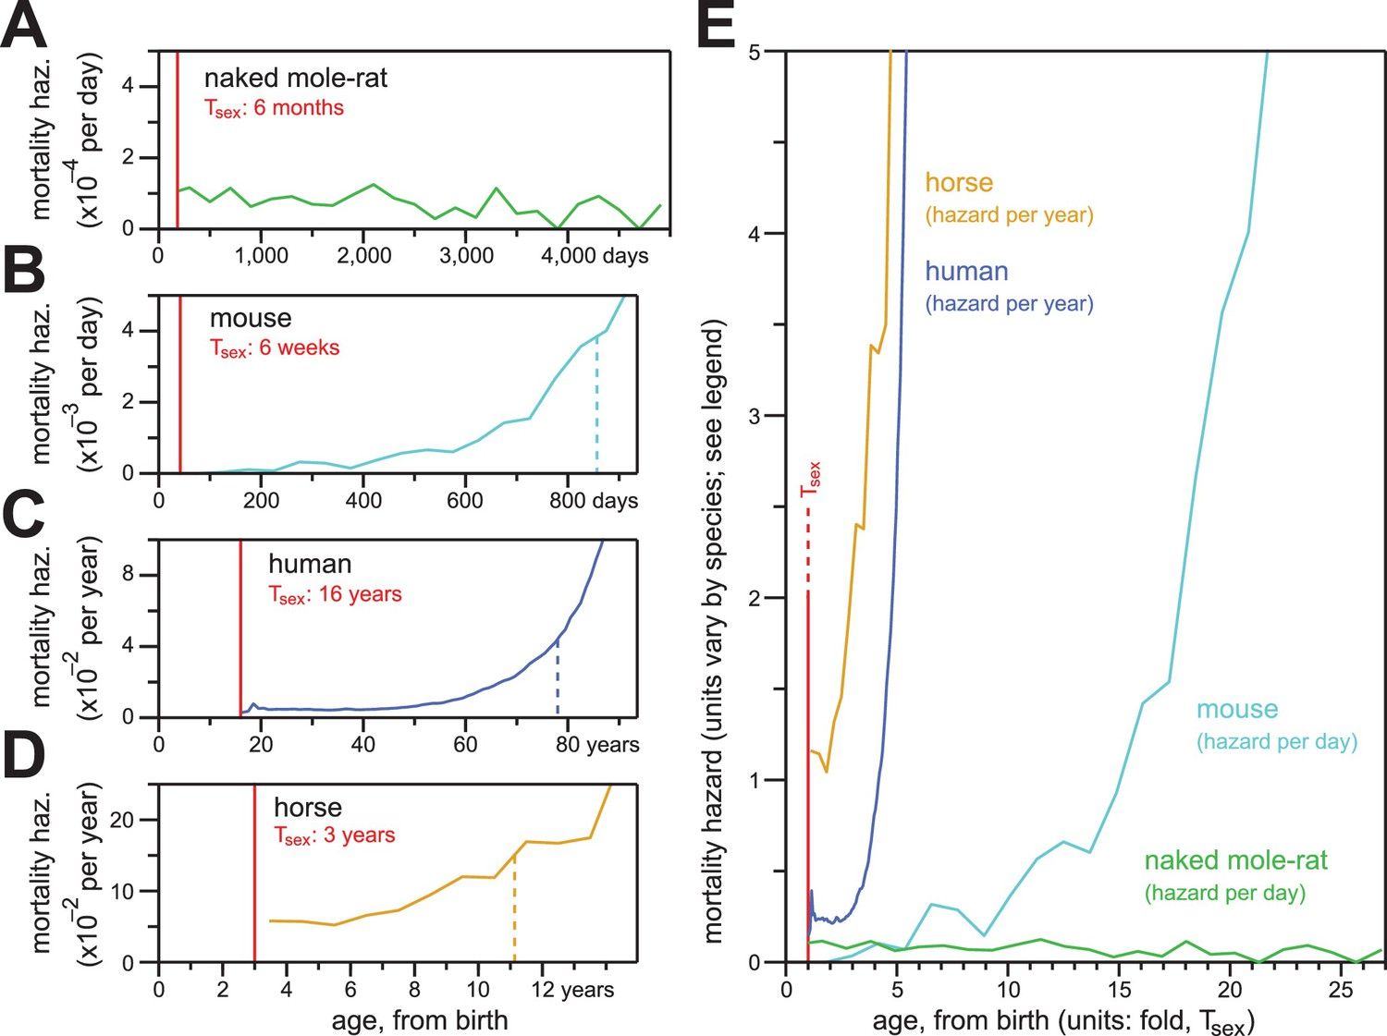
Glires: Rodentia

Slide 18
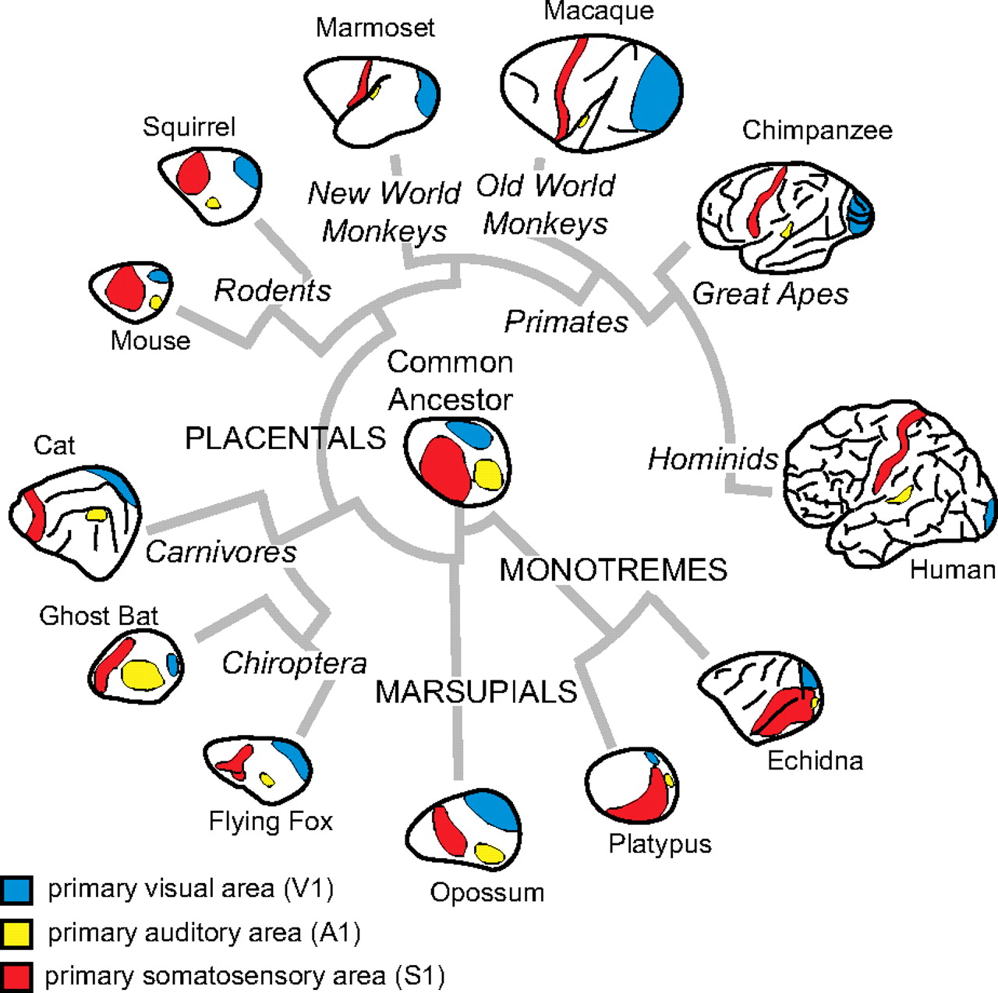

Slide 19
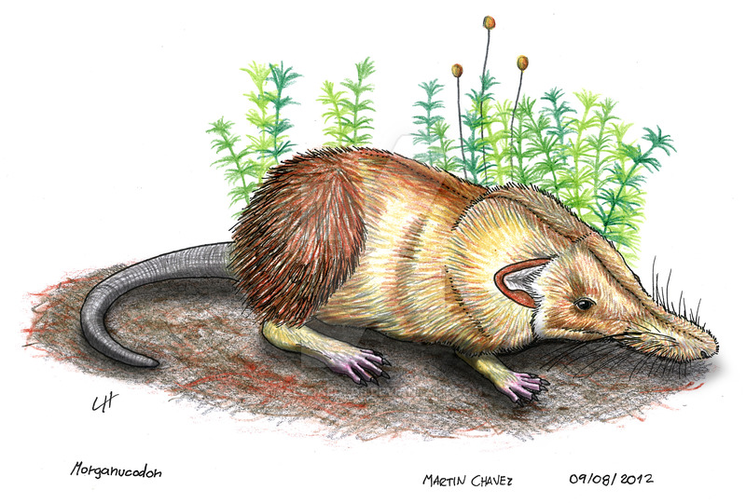
“Shrews”: A Return to Form
Shrew opossums (Metatheria: Paucituberculata)
Elephant shrews (Afrotheria: Macroscelidea)
True shrews (Laurasiatheria: Euliptophyla)
Tree shrews (Archonta: Scandentia)

